Slide 1

R Project DSE5002 JeanPhaundet Dolce 04/20/2025
The Objective is to understand the data to come with a clear analysis of fulfilling the need of a full-time data scientist
There are different job titles, locations, salary pay and experience, so the data needs to be sparse to see the best decision to be made for the CEO.

Slide 2
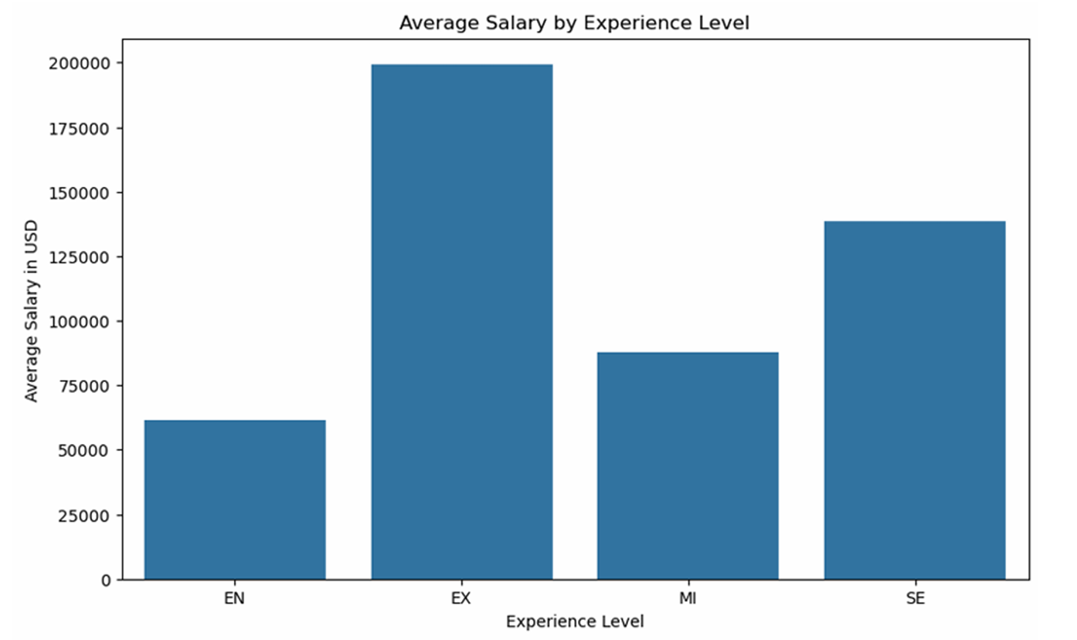
Legend: EN – Entry-Level EX – Executive Level MI – Junior Mid-Level SE – Intermediate Senior Level
This illustrates the average salary based on experience level so the CEO must obtain a data scientist that is SE or EX
The market is competitive which means top talent is going command a hefty salary.

Slide 3
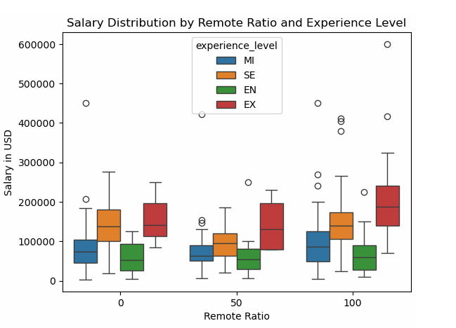
Legend: EN – Entry-Level EX – Executive Level MI – Junior Mid-Level SE – Intermediate Senior Level
This represents the salary for those offshore compared to the US
What the data tells us is that you will pay more for a top talent that is working offshore compared to US. (Currency Change)
There is a smaller gap/range by working 50% remote.

Slide 4
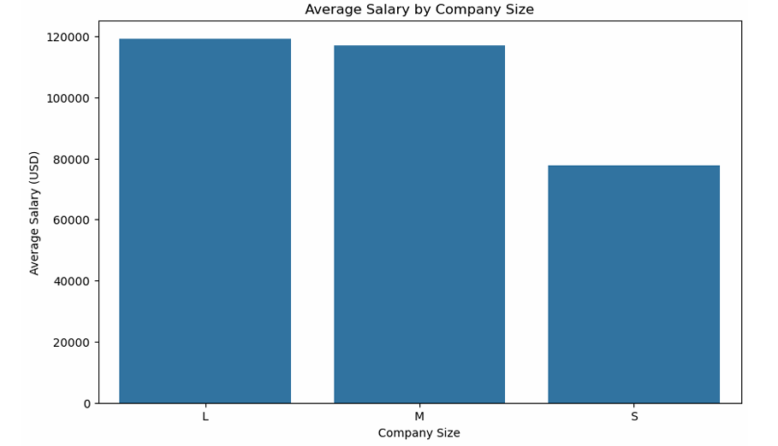
Knowing that the company is expanding, it’s important to see the average salary based on size. There needs to be a projection how the average the company may pay as they continue to grow.
Understanding the average will help choose a data scientist within the parameters of the average.
This graph helps us understand a basis level of what they can pay a data scientist.

Slide 5
Recommendation
Because there is no budget constraint, I would recommend fulfilling the company’s needs with a data scientist that works 50% remote.
According to the chart that highlights Salary Distribution from Remote to US, there is a condensed salary range of all experience levels which means the data is relatively similar making it easier to understand compensation and what a data scientist can expect to be paid.
The CEO can attain an Executive Level data scientist working 50% remote on a similar salary to what a Intermediate Senior would be compensated if they worked in the US.
There is less overhead to pay by the CEO for an Executive Level scientist 50% offshore compared to what will need to be paid out in the US.

